Slide 1
An Overview of Grassroots Education Funding
QUESTION AND ANSWER
Friday, March 8, 2019

Slide 2
Agenda
Illinois Solar for All Overview
ILSFA and Grassroots Education overview
Proposal & submission requirements
Questions

Slide 3
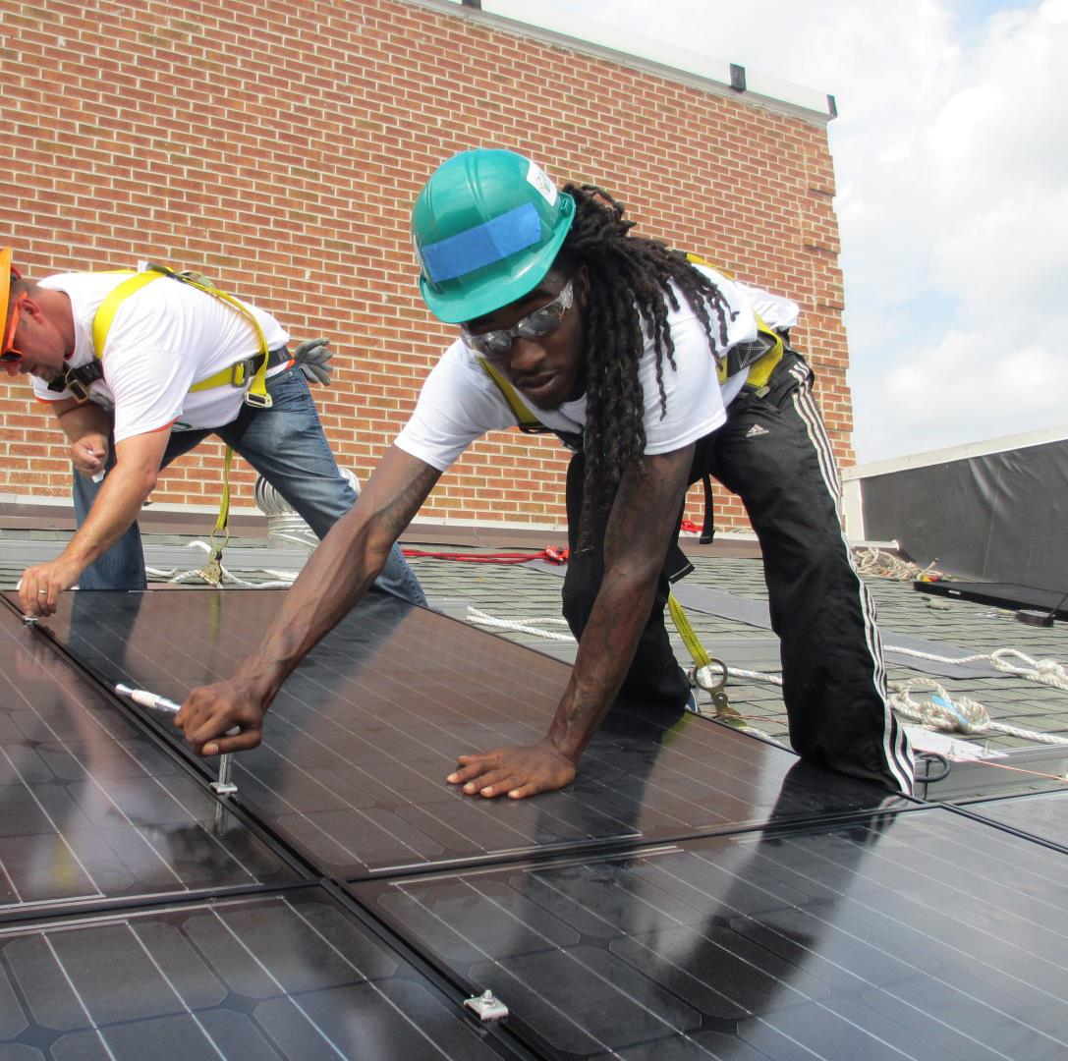
Program Overview
OPTIONAL SECTION LABEL: DELETE IF NOT NEEDED

Slide 4
Illinois Solar for All (ILSFA) Overview
Low-income solar incentive program
Made possible by the Future Energy Jobs Act (FEJA)
ILSFA program goal: strengthen the state’s economy and move Illinois towards a clean energy future
Administered by Elevate Energy on behalf of the Illinois Power Agency (IPA)
Launching in spring 2019

Slide 5
Illinois Solar for All Incentives and Benefits
Solar incentives targeted to low-income and environmental justice communities
Higher value incentives than general market solar program to allow greater benefits to be passed on to qualified participants
Job training requirements accelerate workforce development
Grassroots Education funding to help build awareness in hard-to-reach communities

Slide 6
Who Is Eligible to Participate in ILSFA?
Residential property owners and renters, with an income of 80% or less Area Median Income (AMI)
Non-profit and public facilities serving low-income and environmental justice communities
Targeting 25% of incentives to serve Environmental Justice Communities

Slide 7
Participant Benefits
No upfront costs
Required savings for all participants
Comprehensive consumer protections
Comprehensive vendor requirements
Vendor management and installation inspections requirements

Slide 8
Approved Vendors
Responsible for all aspects of solar installation for Illinois Solar for All projects
Ensure all program requirements are met, including:
Community engagement in the development of ILSFA projects
Minimum number of ILSFA project hours are performed by qualified job trainees
Comprehensive consumer protections
Project sites meet minimum siting requirements
System design and performance standards
Quality assurance standards, including assessments via onsite and photo inspections

Slide 9
ILSFA Sub-Programs
Distributed Generation
Nonprofit/
Public Facility
Community
Solar
Community
Solar Pilots
$7.5 million per year
50% savings on electricity*
No upfront cost to participants
$5 million per year
Nonprofit or Public Sector facilities
Connected to or within low-income/EJ communities
50% savings on electricity*
No upfront cost to participants
$12.5 million per year
Installed in and/or subscribed to by low-income or EJ communities
50% savings on electricity*
No upfront cost to customer
$5 million per year
Funding low-income community solar pilot projects
Competitive procurement
*Savings are calculated by dividing total customer expenses for PV system by total system value passed to customers (typically cost ÷ bill credits).

Slide 10
Grassroots Education Campaign Overview
OPTIONAL SECTION LABEL: DELETE IF NOT NEEDED

Slide 11
Grassroots Education Campaign Overview
Grassroots Education goal:
Ensure the benefits of and opportunities provided by ILSFA reach low-income households and communities throughout the state of Illinois
Campaigns should:
Target geographies and households that are hard to reach
Adapt messaging and methods to provide accessible information about ILSFA, program opportunities, and points of entry into the program
Propose strategies and tactics that applicant organizations have had demonstrated success with
Notes:
Key- Benefits and opportunities to low-income households throughout the state
-In order to be successful at educating hard to reach households, need to meet people where they are.
-target specific audiences, issues, and geographies (or A specific audience/issue/geography); eg will you focus on helping senior citizens understand consumer protections and the benefits of participation in on site or community solar in a particular town? Or on job training for people with barriers to employment in a specific set of neighborhoods?
-Work to disseminate critical project information
-What has your group done or is your group doing now to successfully reach low-income and hard to reach groups?
-e.g. community meetings or events, training sessions, workshops etc.
-development of deliverables, like translated brochures, can be included in campaigns
Campaigns should be measurable. What does your success look like? Capture in your proposal.
- eg number of events, stakeholders reached, exit interviews passed, etc.

Slide 12
Environmental Justice Communities
Environmental Justice Communities (EJCs) demonstrate a higher risk of exposure to pollution based on environmental and socioeconomic factors
Up to 60% of available grassroots education funding will be awarded to Grassroots Education proposals targeting EJCs
2,422 of 9,683 census block groups in Illinois were designated Environmental Justice based on the analysis
Represents appx. 3.1 million people or 1.2 million households
Notes:
Based on the principle that “all people should be protected from pollution and that all populations have a right to a clean and healthy environment.”
Targeting up to 60% of GE funds in EJCs is one way of setting the program up to meet the goal of 25% of project incentives in or serving EJCs
Census block groups

Slide 13
Environmental Justice Communities Map
Online tools have been developed to help you identify Environmental Justice Communities across the state
Environmental Justice Communities are located in 23 of 102 counties in Illinois
Notes:
Highlight that while EJCs are located in 23 counties in IL, they are not “countywide” designations: at a much smaller scale, the census block group.

Slide 14
Champaign-Urbana, Bloomington, Danville, Decatur, Environmental Justice Communities
Notes:
On this mapping tool, you can zoom, type in a specific address, type in the name of a town, etc.

Slide 15
Champaign-Urbana Environmental Justice Communities

Slide 16
Bloomington Environmental Justice Communities

Slide 17
Danville Environmental Justice Communities

Slide 18
Decatur Environmental Justice Communities

Slide 19
Peoria Environmental Justice Communities

Slide 20
Metro East Environmental Justice Communities

Slide 21
Joliet, Aurora, Bolingbrook Environmental Justice Communities

Slide 22
Rockford Environmental Justice Communities

Slide 23
Chicago Environmental Justice Communities

Slide 24
Grassroots Education and Approved Vendors
Campaigns should:
Directly and indirectly drive program participation
Campaigns should not:
Directly support particular Approved Vendors
In geographies without Approved Vendors, grassroots education campaigns may facilitate connections between communities and approved vendors
Approved Vendors should be invited to participate in a transparent manner
Notes:
Education can and should drive action but campaigns should not market for or steer folks to specific Approved Vendors– this is commercial marketing, not grassroots education.
Some communities that are not well represented by the solar industry may have interest in ILSFA but be unable to participate because there are no Approved Vendors. Approved Vendors can participate in events organized by GEs as long as all approved vendors have the same opportunity to participate.
No payment to funded grassroots orgs by Approved Vendors during or for 6 months after the end of the contract period.

Slide 25
Proposal Requirements
OPTIONAL SECTION LABEL: DELETE IF NOT NEEDED

Slide 26
Grassroots Educator Eligibility Requirements
Be organized as a non-profit (or partner with a non-profit fiscal sponsor)
Regularly provide services to low-income areas or Environmental Justice Communities
Demonstrated ability to provide:
Outreach, education, training, or program delivery for energy-related programs or services
Outreach, education, training, or program delivery for low-income residents, workforce development stakeholders, or other community organizations and ILSFA participants and stakeholders
Notes:
-Being organized as a non-profit means that you’re registered with the Illinois Secretary of State as such. No political or trade groups.
-Fiscal sponsorship discussed on next slide
-Should already be servicing low-income people in the area you propose your education campaign in

Slide 27
Collaborative Partnerships
Collaboration to leverage resources and strengths (in focus or geography) is encouraged
Fiscal sponsorship for groups that are not registered non-profits
Proposals should clearly specify roles and responsibilities
Proposals should demonstrate an equitable approach towards decision making
Notes:
If your organization is not a non-profit registered with the IL secretary of state, can use fiscal sponsorship. Fiscal sponsors cant act on behalf of for-profits, trade or political groups.
If you’re using a fiscal sponsorship, the sponsor is the lead applicant and submits the proposal on behalf of the partnership.
For profit firms can be used for discreet activities (eg providing food for an event) but cannot make up more than 40% of campaign budget

Slide 28
Award Information
First round awards:
Up to $500,000 is available for grassroots education (up to $50,000 each for selected organization)
Subsequent years:
Up to $1.5 million available for grassroots education
Notes:
Limited first round amount to give us time to focus on key stakeholders and topics, and measure effectiveness of campaigns to inform future rounds.
Organizations that submit collaborative partnerships could potentially be awarded more than $50,000 total.
These amounts are maximums/”up tos”– how much is awarded will depend on the quality and diversity of proposals.

Slide 29
Request for Proposals (RFP) Evaluation Process
Final scope of work, campaign goals and metrics, and award amount corresponding to work to be provided will be negotiated during the selection process
Campaign Scoring Rubric
Strength of the Campaign | 40 points
Proposed Metrics | 20 points
Experience of Applicant | 15 points
Cost and Value of Delivery | 25 points
Total Possible Score | 100/100 points
Minimum Score Required | 50/100 points
Notes:
-Proposals must meet the minimum score required (50 points) for further consideration.
-Proposals meeting this requirement will be rank ordered by score.
-BUT administrator may select proposals out of rank order to support the goal of prioritizing up to 60% of funding for grassroots education benefiting EJCs
AND/OR ensuring sufficient diversity of geography, and perhaps education topics and delivery mediums

Slide 30
Areas of Interest
Applicants can propose campaigns built around one or more of the following areas of interest:
Participant benefits
Job training
Environmental justice
Community engagement
Hard-to-reach communities
Geographically diverse communities
Effective engagement strategies and tactics
General energy and solar education (in some contexts)
Deferred maintenance and lack of solar readiness (incorporated into campaigns as appropriate)
Notes:
-This is not an exhaustive list- innovative campaigns based on the specific needs of communities is encouraged.
-Can focus on one or multiple areas of interest
-Participant benefits
--educating potential program participants about: solar basics, program benefits, program requirements, consumer protections, solar-ready properties, finding Approved Vendors, etc.
-Job training
--job training requirements and opportunities, connecting qualified trainees to Approved Vendors, the hiring process and solar career development, disseminating ILSFA solar jobs resources and tools, etc
Environmental justice
--EJC goals and requirements, methodology, self designation, etc.
-Community engagement
--the role of communities and community organizations in working with ILSFA vendors, benefits of ILSFA to communities, etc.
-Hard-to-reach communities
--Campaigns with an emphasis on targeting seniors, very low-income populations, communities with language barriers, etc.
-Geographically diverse communities
--focus on isolated or rural communities, communities with an absence of service providers or community orgs, unusual housing stock, etc- less likely to be reached by traditional marketing techniques
-Effective engagement strategies and tactics
--expertise in community building, outreach, education, etc.
-General energy and solar education (in some contexts)
--Esp. relevant during this first round of campaigns as solar is largely new in Illinois; GE funds meant to educate audiences on benefits/opportunities of ILSFA, but this might be needed.
-Deferred maintenance and lack of solar readiness (incorporated into campaigns as appropriate)
--We know that these are crucial barriers mostly unique to low income housing stock

Slide 31
Format and Required Information for RFP Submission
Cover letter
Campaign description
Description of need
Organizational expertise
Measurement
Timeline
Budget
Contract
Attachments
Submit all information electronically no later than 11:59 p.m. on March 26, 2019 to grassroots@illinoissfa.com
Notes:
Cover letter
-project team and roles
-partner organizations and relationship to lead org (if applicable)
-fiscal sponsorship/eligibility of each org (if applicable)
-Contact information
Campaign description
-What is the grassroots education campaign you’re proposing?
-Describe:
--stakeholders that will be targeted
--areas or topics of interest
--rationale
--strategies/tactics you’ll use
--details about messaging, events, and deliverables
--organizational experience/approach to effective stakeholder engagement in targeted communities
--specific geographies to be targeted and where events will be held
Description of need
--Why will the campaign help achieve the implementation goals of Illinois Solar for All?
--What makes this campaign stand out and how does it fill the need?
--What risk does it address (e.g. leaving out a subset of people) and what is the likely outcome if the campaign is not executed?
Organizational expertise
--Why is your organization qualified to deliver this campaign?
--What specific experience does your organization have in engaging or educating specific stakeholders/areas of interest?
--What experience does your organization have with the proposed strategies, tactics, methods, and deliverables?
Measurement
--How will the success of the campaign be measured? Provide specific metrics.
Timeline
-details on timeline for campaign development, execution, evaluation, reporting, and close out.
Budget
-Use a format you typically use, include detailed breakdown of program expenses including:
-personnel
-direct expenses
-amounts paid to parnters/subcontractors
-include allocations for partners, if applicable.
Contract
-statement certifying that you agree to contract with us in accordance with terms and conditions in the subcontractor contract (included with the RFP); include any objections in your response.
Attachments
1. Board list
2. Optional references/letters of support
3. Bios of key personnel
4. certificate of good standing from the IL sec of statefor not for profit corp status
5. Current IRS designation letter for 501©3 status, if applicable
6. Most recent IRS Form 990, if any
7. Budget attachments, as needed
Submit proposals in adobe PDF format.

Slide 32
Key Dates
Wednesday, March 13: Questions due (submit questions to grassroots@illinoissfa.com)
Monday, March 18: Answers to questions published
Tuesday, March 26: Proposals due

Slide 33
Questions?

Slide 34
Important Contacts
Laura Oakleaf,
Program Manager
Laura.Oakleaf@elevateenergy.org
(773) 906-5134
Elizabeth Corrado, Grassroots Education
Elizabeth.Corrado@elevateenergy.org
(773) 321-2684
www.IllinoisSFA.com

