Slide 1
Advisory Committee Quarterly Meeting
June 23, 2026
Jennifer W. Brown, Associate Director, Illinois Solar for All
Patrice McFarlin, Principal, Encolor
Notes:
To share video audio on a Teams meeting, click the "Share" button in the meeting controls, then toggle on the "Include system audio" option before selecting the screen or window you want to share.

Slide 2
Agenda
Housekeeping and Ground Rules
Last Meeting Recap
Topic 1: Updates to AV Manual
Topic 2: Project Selection
Closing/Next Steps

Slide 3
Housekeeping and
Ground Rules
Be kind and use mute.
  Please put yourself on mute while presentations are taking place.
Raise your hand or put your question in the chat.
  Use the “raise your hand” icon to indicate you have a question or share your question in the chat. We will address all questions.
Be present.
  Please be on camera and focus on this meeting only.

Slide 4
Last Meeting Recap and Committee Updates
Patrice McFarlin, Principal, Encolor

Slide 5
Last Meeting Recap
February 2026 Meeting
  Member Attendance
    16 members attended
  Meeting topics
    Topic 1: Grassroots Education
    Topic 2: Participant Referral Process
March 2026 Special Meeting
  Member Attendance
    10 members attended
  Meeting topics
    Topic: Low Income Discount
Notes:
Introductions and Advisory Committee Overview: Members introduced themselves sharing their backgrounds, motivations, and expertise, with discussion revealing diverse representation from approved vendors, community organizations, residents, and legal professionals, while Patrice explained the committee's role in providing meaningful conversations and recommendations to improve program delivery
Advisory Committee Recruitment Process: The committee discussed the highly competitive recruitment process that received 29 community resident applications, with conversation focusing on lessons learned about role category definitions and the need to update governing documents regarding organizational attendance, committee roles, and term limits
Approved Vendor Manual Overview: Olivia presented the comprehensive approved vendor manual covering 20 chapters from program introduction to complaint management, with extensive discussion about project prioritization systems, participant savings requirements (50% minimum), critical service provider eligibility, and the annual manual update process that includes stakeholder feedback periods
Special Topic Reports Discussion: ILLUME presented their evaluation approach and sought input on potential special topic research areas, with committee members expressing strong interest in federal policy impact studies, home repair barrier analysis, and examination of the discontinued Bright Neighborhoods pilot program
Residential Solar Small Program Budget Communication: Isabel discussed the unprecedented challenge when the residential solar small program budget was fully allocated for the first time in program history, requiring rapid development of new messaging strategies and communication plans to manage stakeholder expectations and waitlist processes
2025 Program Results Analysis: David from the IPA presented data showing that two approved vendors accounted for 70% of the 1,460 residential small projects completed in 2025, with discussion revealing insights about simplified income verification processes and geographic concentration patterns favoring Cook County and Metro East regions.

Slide 6
Topic 1: AV Manual Updates
Olivia Salazar-Mendez, Director, ILSFA

Slide 7
CRGA and 2026 Long-Term Renewable Resources Procurement Plan
CRGA
  On October 30 2025, the Illinois General Assembly passed the Clean and Reliable Grid Affordability Act ("CRGA"). The bill was signed into law as Public Act 104-0458 by Governor J.B. Pritzker on January 8, 2026, and will take effect on June 1, 2026.
  CRGA is a comprehensive energy bill aimed at enhancing energy reliability, affordability, and sustainability by facilitating the development of new battery storage projects, improving energy efficiency, and introducing new long-term energy planning.
2026 Long-Term Renewable Resources Procurement Plan
The Illinois Power Agency's Long-Term Renewable Resources Procurement Plan guides the Agency's activities related to the development of new renewable resources to support the Illinois Renewable Portfolio Standard.

Slide 8
CRGA Updates
Workforce Requirements: At the start of each Program Year, Approved Vendors are required to identify which workforce requirement they will comply with, either job training or Minimum Equity Standards (MES)
Advance of Capital: Allows the Agency to propose such payment structures to maximize equitable participation in the Program and overcome challenges facing the development of projects
  The process for establishing the levels of advanced capital and the mechanisms by which the applicant will demonstrate the need for such an advance will be developed through a stakeholder process during the 2026-2027 Program Year

Slide 9
CRGA Updates
Non-Profit and Public Facilities Requirements: Qualifying non-profits and public facilities that can demonstrate they serve income-qualified or Environmental Justice Communities “may potentially qualify for the program, regardless of physical location.”
  The Agency will develop eligibility criteria and solicit stakeholder feedback on the proposals, including on the timing of implementation of these proposals, for inclusion in a future Long-Term Plan
Income Verification Methodology: The Agency extended the self-attestation option to participants in the Residential Solar (Small) sub-program who reside in an Income-Eligible Community for the 2026-2027 Program Year
  The Agency will proactively explore approaches that make the income verification process less burdensome for residents of low-income or Environmental Justice Communities through stakeholder processes for potential incorporation in the future

Slide 10
CRGA Updates
System Size and Co-Location Requirements:
  Distributed generation projects cannot have an aggregate size greater than 5MW
    An affidavit is required stating that the project is not affiliated with another project that, were they found to be co-located, would create an aggregate size greater than five MW nameplate capacity
  Community Solar projects cannot have an aggregate size greater than 10MW
    An affidavit is required stating that the project is not affiliated with another project that, were they found to be co-located, would create an aggregate size greater than 10 MW and that the parcel has not been divided within the preceding five years

Slide 11
Small and Emerging Business Approved Vendors
Entities that meet the definition of either a “small business” or “emerging business” registering as Approved Vendors in the Illinois Shines Program after May 31, 2026, will be able to request SEB designation within the Illinois Shines Approved Vendor registration process
To receive designation as a Small and Emerging Business in both Illinois Shines and ILSFA, the Approved Vendor will have to demonstrate one of the following:
  Qualification as an “emerging business”: Demonstration that the entity has been authorized to do business in a U.S. state, district, or territory for less than three years.
  Qualification as a “small business”: Demonstration that the entity (1) is independently owned and operated, and (2) has a gross revenue of less than $4 million in the previous calendar year.

Slide 12
Small and Emerging Business Approved Vendors
Projects submitted by Small and Emerging Businesses are eligible for additional prioritization point during Project Selection
  If Project Selection is not triggered, Small and Emerging Businesses will receive early access to the rolling submission window
Small and Emerging Businesses may deduct the 5% collateral requirement from the REC payment rather than having it due after contract execution, with a five-project cap per Approved Vendor

Slide 13
Low Income Discount Rates and Savings Considerations
Background has been provided about LIDR implementation for utilities
The current ILSFA Disclosure Forms do not account for LIDR and therefore may overestimate the value of electricity to LIDR customers as well as the estimated savings
  Disclosure Forms currently affected by the LIDR will no longer display the savings calculation
  If DG projects in impacted utilities are not 100% savings, additional review will take place to verify that the savings requirements are met with LIDR considerations
Due to this update, CS projects with a no-cost subscription commitments and no-cost Residential (Small) projects will be prioritized during Project Selection

Slide 14
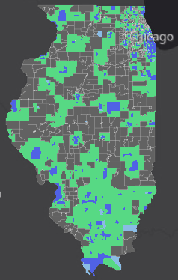
Non-Profit and Public Facilities Project Requirements
Projects located in census blocks adjacent to Environmental Justice Communities or Income-Eligible Communities will be eligible to participate in the Non-Profit and Public Facilities sub-program
  An adjacent census block is defined as a neighboring statistical geographic area that shares a common boundary with a census tract, which is, at that point in time, designated as an Environmental Justice Community or an Income-Eligible Community
  Projects must still demonstrate a sufficient connection to, and input from, members of the IEC or EJC members the facility and/or the non-profit or public facility serves

Slide 15
Submission Windows
July 20 – July 31, 2026: Residential Solar (Large)
August 3 – August 14, 2026: Non-Profit and Public Facilities
September 14 – September 25, 2026: Residential Solar (Small)
September 28 – October 9, 2026: Community Solar

Slide 16
Updates for 2026-2027 Program Year
Updates were made on the same schedule as the Approved Vendor Manual and incorporated changes from CRGA, 2026 Long Term Plan and considerations from the early closing of the 2025-2026 Program year.
  Small and Emerging Business and no-cost prioritization updates discussed in the Approved Vendor Manual section of this presentation
  If the incentive value of total submitted projects for the Home Repairs and Upgrades Initiative exceeds the available Home Repairs and Upgrades Initiative budget, Project Selection will occur for Home Repairs and Upgrades Initiative projects independently
  CRGA updated the definition of community solar allowing projects up to 10 MW however, points will now be applied to Community Solar projects equal to or less than 5 MW to encourage smaller project submissions due to concerns that individual projects exceeding 5 MW may exceed the available budget
  Projects impacted by the early closure of the 2025-2026 Program Year may apply in the 2026-2027 Program Year and receive an additional prioritization point if Project Selection is necessary in the project’s sub-program following the initial submission window

Slide 17
Topic 2: Project Selection
Lawrence Kotewa, Chief Engineer, ILSFA

Slide 18

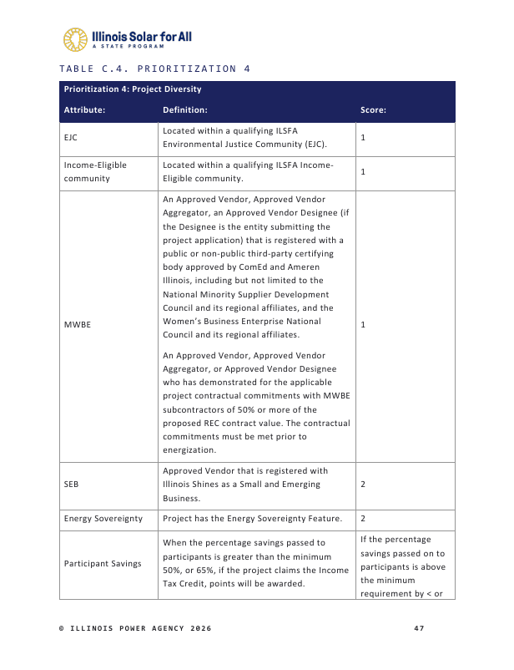
What is Project Selection?
Project Selection is required when:
  The total incentive value of eligible projects submitted for a given sub-program exceeds that sub-program budget during the sub-program's 10 business day initial submission window
  The EJC or Energy Sovereignty carveouts are not met
Project Selection is designed to fairly prioritize projects for funding when there is not enough budget in a sub-program to fund all projects submitted.​

Slide 19
How Does Project Selection Work?
Prioritization Stages
Environmental Justice Community Selection (Prioritization 1)
Energy Sovereignty Selection (Prioritization 2)
Income-Eligible Community Selection (Prioritization 3)
General Remaining Selection (Prioritization 4)
Projects are:
Prioritizations 1 and 2 represent legislative carveout requirements
Scored based on a rubric unique to each of the four stages​
Ranked by their scores, highest to lowest, to determine selection based on budget availability​
Randomly ordered for selection if tied with other projects​
Moved to the next prioritization stage's selection if not selected in a given stage​

Slide 20
Carveout and Income-Eligible Communities Selection
Prioritization Stages
Environmental Justice Community Selection (Prioritization 1)
Energy Sovereignty Selection (Prioritization 2)
Income-Eligible Community Selection (Prioritization 3)
Prioritizations 1 and 2 represent legislative carveout requirements
  For each Program Year, 25% of each sub-program budget will be reserved for EJC and Energy Sovereignty projects, respectively.
    The EJC carveout is reserved for the duration of the program year, while the ES carveout is held until January 1.
    Carveout funds will remain reserved if the total incentive value of EJC or ES projects submitted is less than 25% of the sub-program budget
  For each Project Selection, up to 25% of a sub-program budget may be selected at this stage.

Slide 21
Project Selection Protocol Updates
Project Selection Protocol Update:
Early Access Window for Small and Emerging Business
  Two-day window opens prior to opening of rolling submissions
    25% of budget remaining after the initial submission window made available for SEBs during this time
    In Residential Solar (Small), batches submitted in Early Access Window cannot exceed $200,000
2. Prioritization Points for Small and Emerging Businesses
  Two points for an Approved Vendor that is registered with Illinois Shines as a Small and Emerging Business
    The addition of points for SEBs in the 2026-2027 Project Selection Protocol is intended to address SEB prioritization for the initial submission window.
Notes:
The Message Framework contains core message pillars that support consistent, clear, and audience-aligned content. These pillars focus on the audience benefit, how the program works, and the protections in place for participants.
The content development guide within the framework provides key messages and supporting proof points for each pillar, helping program team members build credible, focused content across formats and channels.

Slide 22
Project Selection Protocol Updates
Project Selection Protocol Update:
Prioritization for Smaller Community Solar Projects
  Project Selection will prioritize projects <5 MW and contain no penalty for co-location for projects >5 MW
    While the Clean and Reliable Grid Affordability Act increased the maximum CS project size to 10 MW, this update is intended to prevent large projects from complicating the various carveouts and funding sources
    In the General Selection stage, the Protocol also gives 30% priority to projects <2MW
Notes:
The Message Framework contains core message pillars that support consistent, clear, and audience-aligned content. These pillars focus on the audience benefit, how the program works, and the protections in place for participants.
The content development guide within the framework provides key messages and supporting proof points for each pillar, helping program team members build credible, focused content across formats and channels.

Slide 23
Project Selection Protocol Updates
Project Selection Protocol Update:
Thresholds in the General Remaining Selection
  For each sub-program, Prioritization 4 will select from the following attributes until 30% of the total sub-program incentive value is reached for that category
    For Community Solar, projects under 2000 kW, rather than 500 kW, will be selected
    For Residential, projects which support geographical diversity between Group A and Group B will be selected
    For Non-Profit and Public Facilities, projects which support entity diversity between nonprofits and public facilities and projects under 100 kW will be selected
Notes:
The Message Framework contains core message pillars that support consistent, clear, and audience-aligned content. These pillars focus on the audience benefit, how the program works, and the protections in place for participants.
The content development guide within the framework provides key messages and supporting proof points for each pillar, helping program team members build credible, focused content across formats and channels.

Slide 24
Project Selection Protocol Updates
Project Selection Protocol Update:
No Cost Offers in Residential Solar
  Two points for Residential Solar (Small) projects with no-cost offers in each scoring stage of Project Selection
    In Residential Solar (Small), most projects utilize no-cost offers. Based on recent trends, the Program anticipates most projects are capable of claiming these points.
2. No Cost Offers in Community Solar
  Two points for Community Solar projects offering no-cost subscriptions
    The addition of points for no-cost offers is intended to ensure an economically beneficial offer amid the rollout of the utility Low-Income Discount Rates for income-eligible customers
Notes:
The Message Framework contains core message pillars that support consistent, clear, and audience-aligned content. These pillars focus on the audience benefit, how the program works, and the protections in place for participants.
The content development guide within the framework provides key messages and supporting proof points for each pillar, helping program team members build credible, focused content across formats and channels.

Slide 25
Project Selection Protocol Updates
Project Selection Protocol Update:
PY26 Carryover Prioritization
Projects impacted by the early closure of the 2025-2026 Program Year may apply in the 2026-2027 Program Year and receive an additional prioritization point if Project Selection is necessary in the project’s sub-program following the initial submission window
Notes:
The Message Framework contains core message pillars that support consistent, clear, and audience-aligned content. These pillars focus on the audience benefit, how the program works, and the protections in place for participants.
The content development guide within the framework provides key messages and supporting proof points for each pillar, helping program team members build credible, focused content across formats and channels.

Slide 26
Q&A

Slide 27
Next Steps
Next Meeting:
  This is the last meeting for the PY 25/26 program year. The next meeting will take place in the fall.
Sign-up for ILSFA emails:
  https://www.illinoissfa.com/stay-updated/
Notes:
Address term limits and subcommittees

Slide 28
Thank you for your time!

